Slide 1
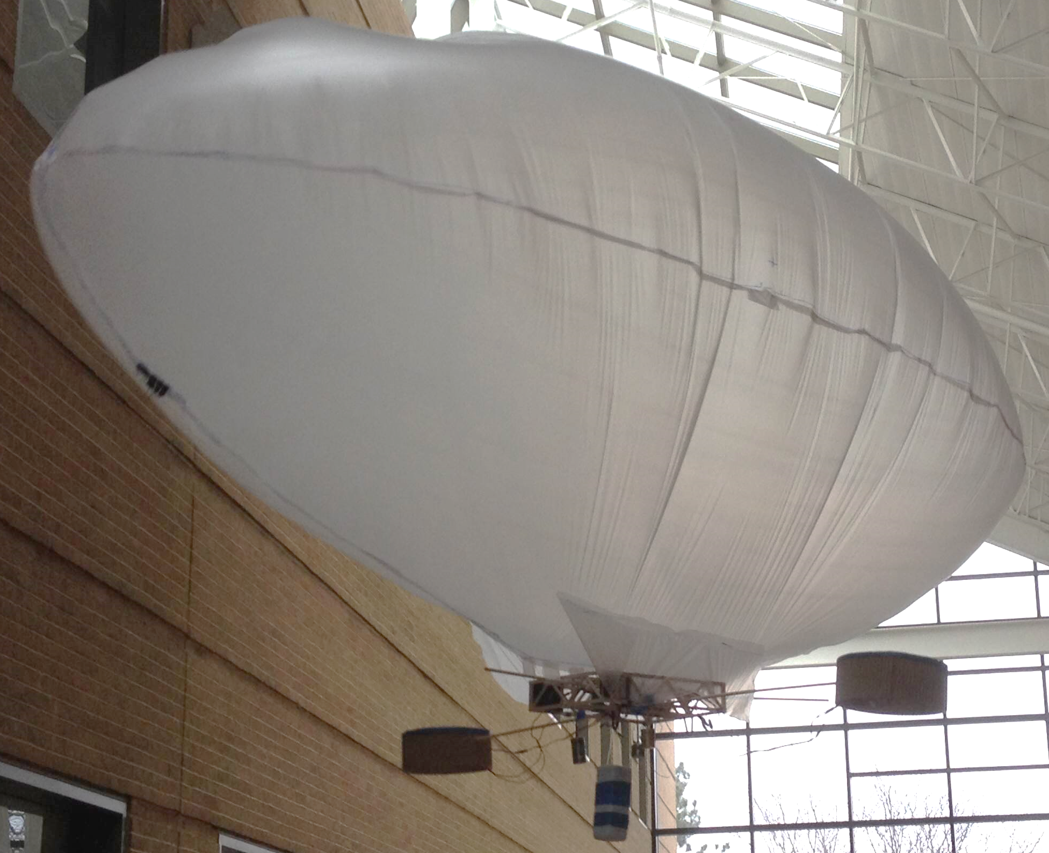
Earth’s Prototype of NASA’s 10-km Earth Blimp: Design, Progress, Schedule and Management Plan
Alex Berka
Valerie Chen
Dietrich Klemm
Umang Lohia
Carlos Valls
Engineering Interns
Team Plane Janes
Space Science Technologies
April 3, 2014

Slide 2
Introduction
Problem: NASA needs a blimp to survey the Earth’s surface from 10 km
Carry 100 g camera for a year
Weigh less than 1 kg
Fit in 0.23 x 0.56 x 0.91 m container undeployed
Use only NASA materials
Task
Design, build, test sea-level Earth prototype of 10-km blimp system
Design project schedule and management plan
Purpose
Present design and construction status
Present team management plan and future timeline

Slide 3
Summary
Blimp design: Prolate spheroid
Meets all NASA requirements
Wide motors and differential thrust for yaw
Microcontroller controls pitch of motors
System mass: 706 g/1000 g
Progress
Blimp complete except fin
First test flight complete
To be completed
Stabilizing membrane fin
Blimp testing, alterations, and pilot practice
Project on schedule, work evenly divided

Slide 4
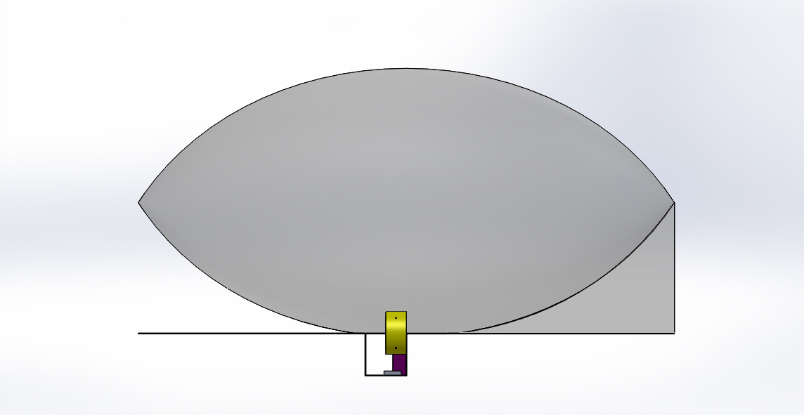
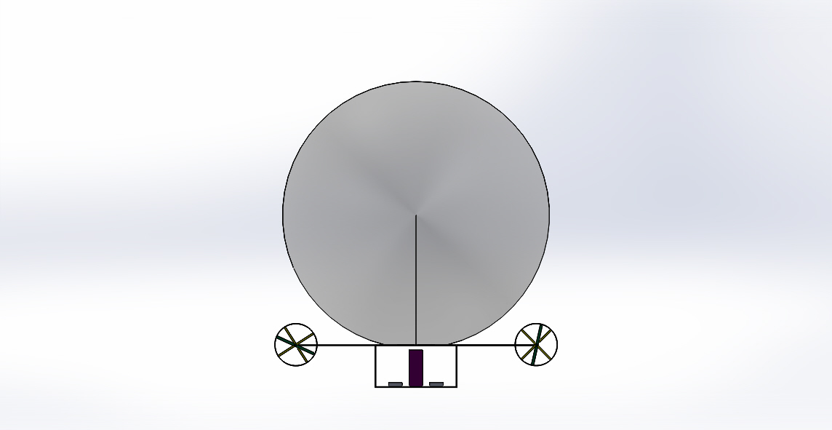
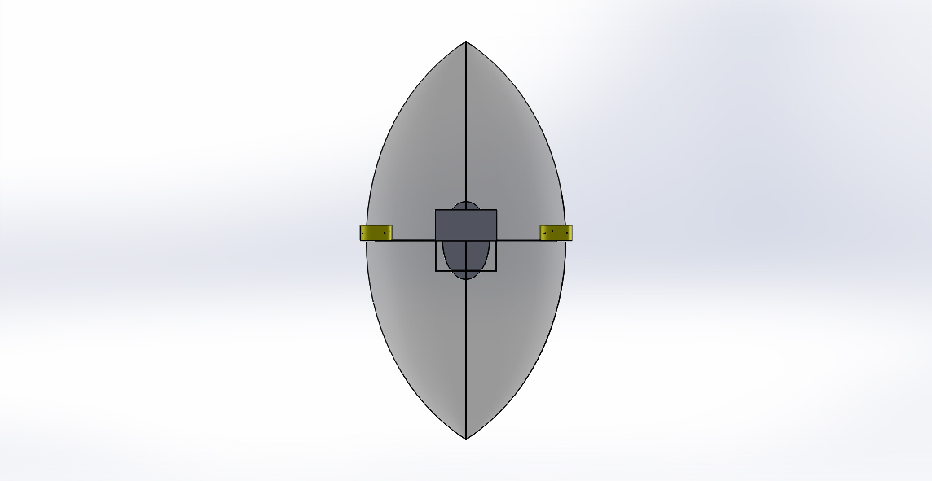
Blimp Design
Side View
Front View
Camera Payload
Dowel Rod
Membrane Fin
Bottom View
Battery Packs
Envelope
Gondola
Motor

Slide 5
Blimp Design
Side View
2.55 m
Front View
0.98 m
Bottom View
1.37 m
12 in (0.305 m)
8 in (0.203 m)

Slide 6
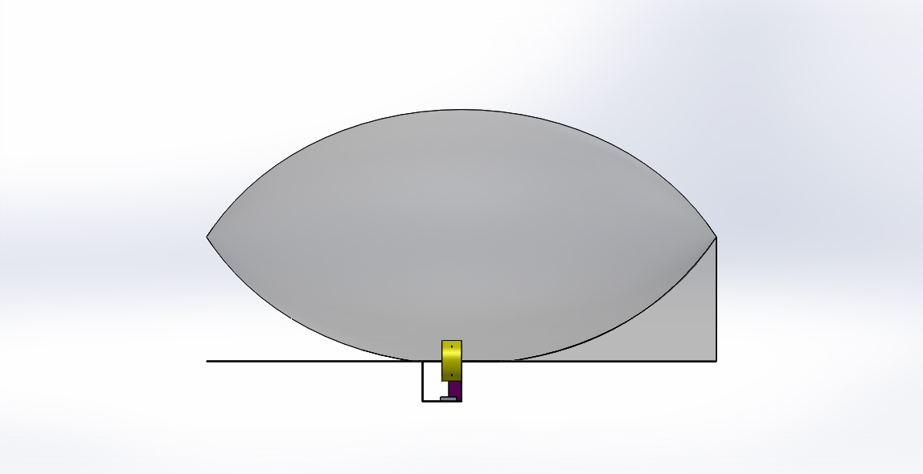
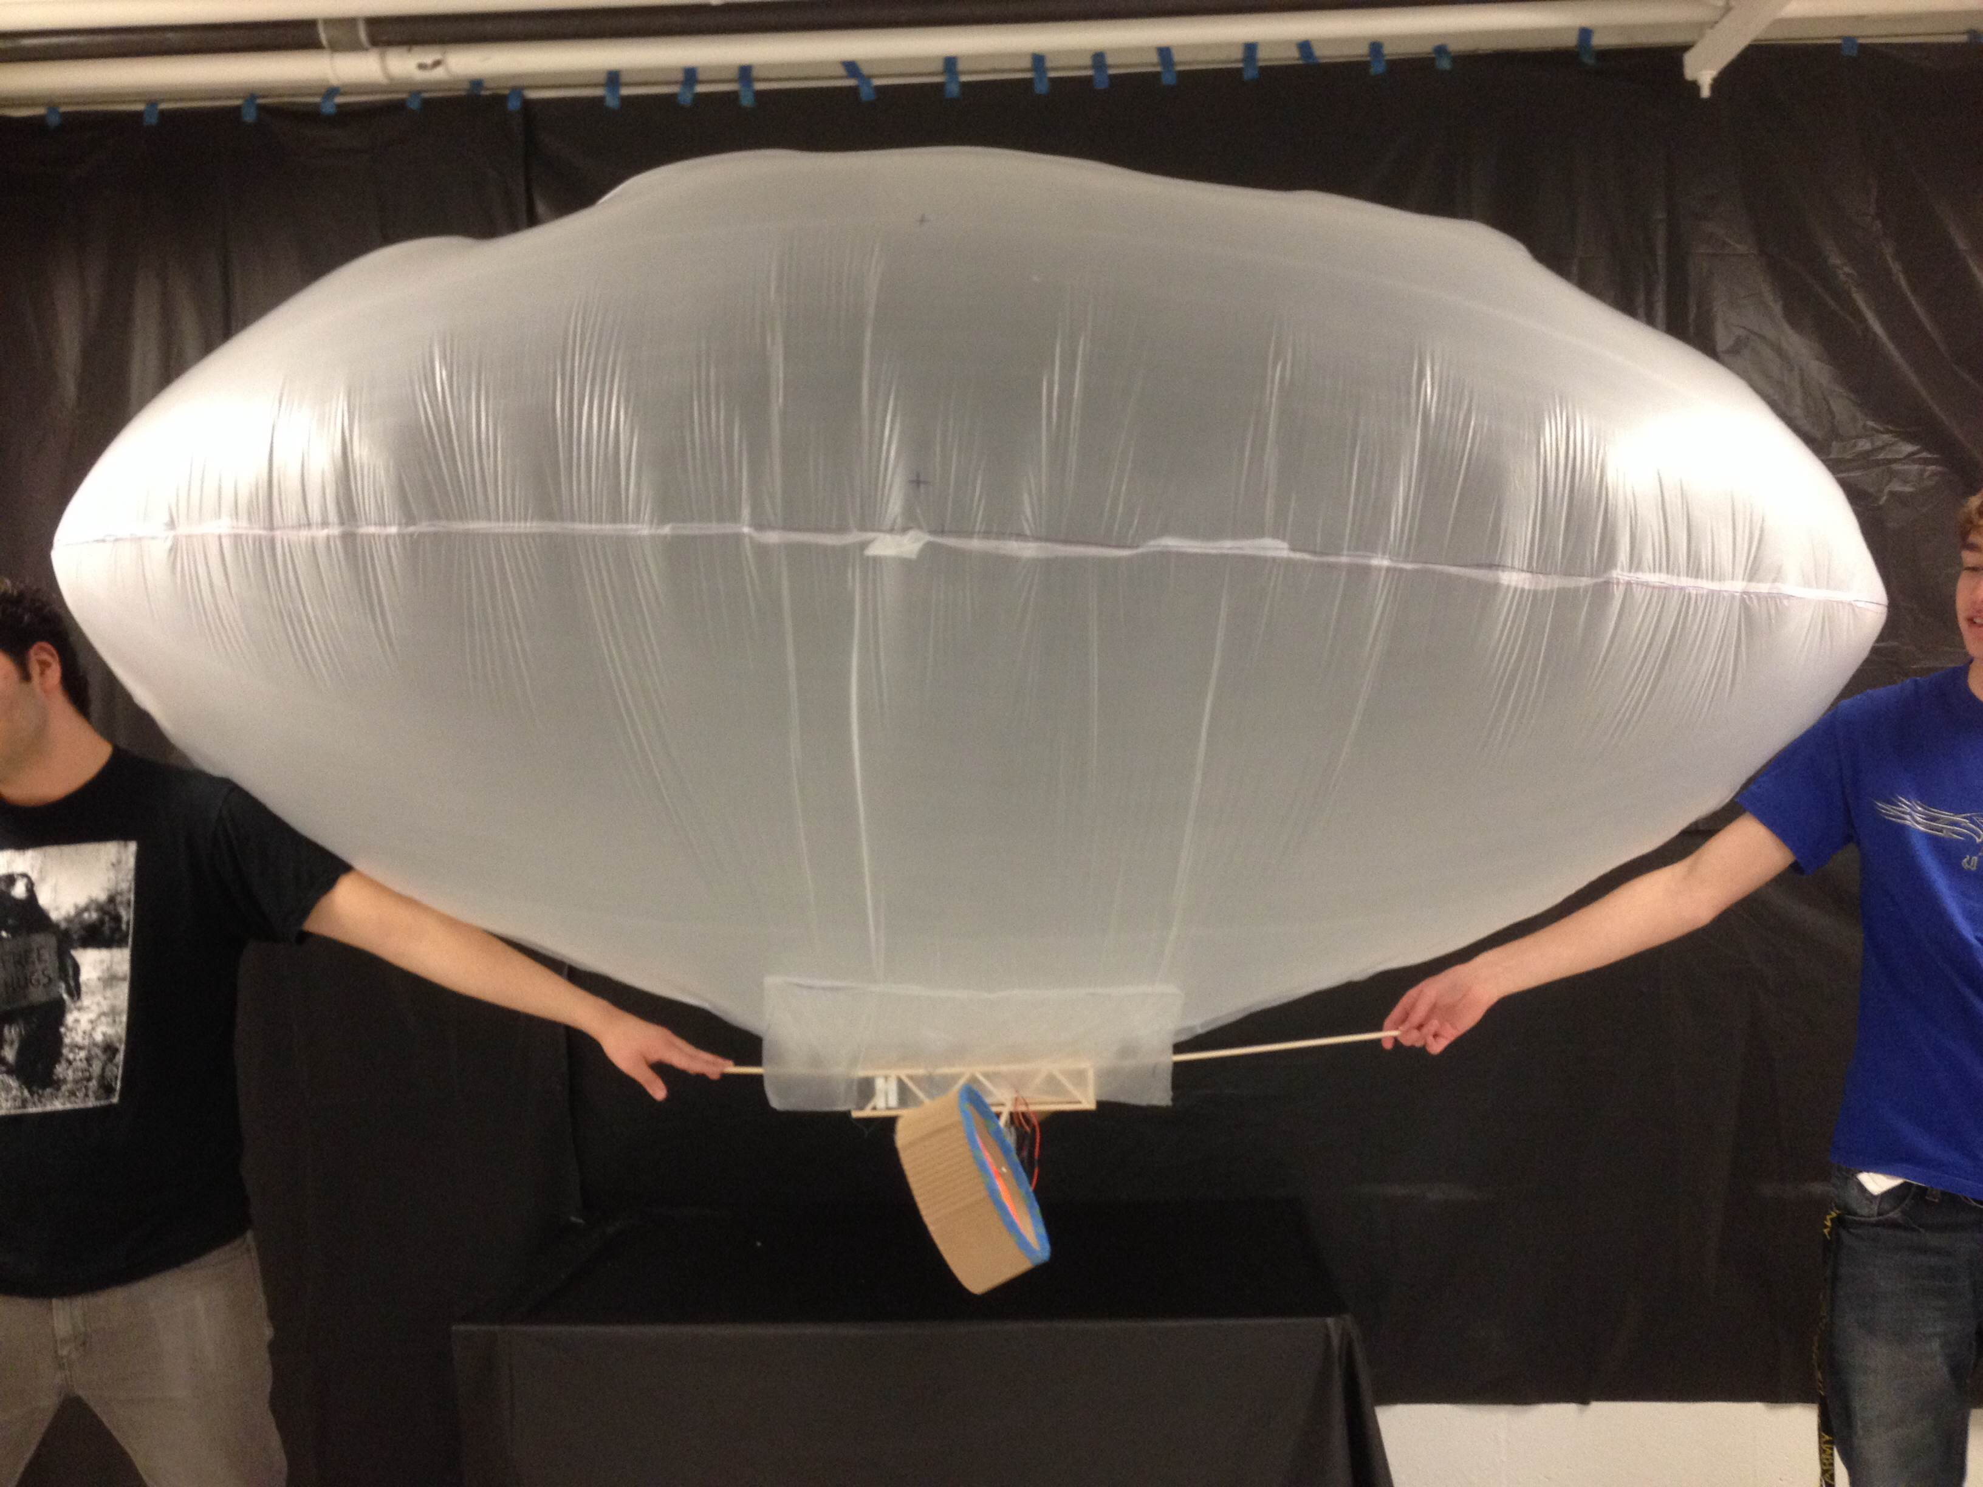
Envelope: Provides Lift
Design: Prolate spheroid (football)
Aspect ratio of 2.5:1 (diameter: length)
Three internal seams, one external (bottom)
Gross Lift: 1025 g
Estimated C_{D} of 0.26
Progress
Completed full scale envelope
Need to finish envelope alterations
Need to attach fin to envelope
2.55m
0.98m

Slide 7
Gondola: Holds Propulsion & Electrical Systems
Gondola constructed out of six Warren trusses
Balsa Wood Struts
Bass Wood Chord
Bass Wood Chord

Slide 8
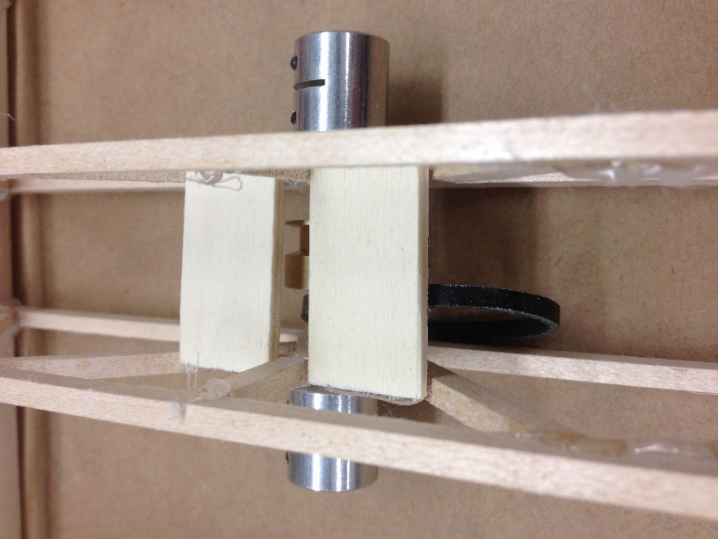
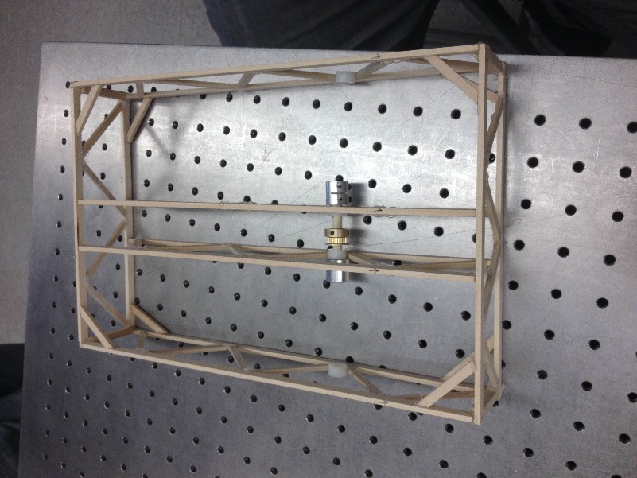
Gondola: Holds Propulsion & Electrical Systems
Stiffness to mass of 1500 N/mg
Guard panels to protect wires
1 in (0.03 m)
1 in (0.03 m)
Center Mechanism
Guard panels
12 in (0.3 m)

Slide 9
Membrane Fin: Stabilizes Blimp
Front
Back
Intended for yaw stabilization
Made of membrane material
Supported by dowel rod
Detachable from gondola
Membrane Fin

Slide 10
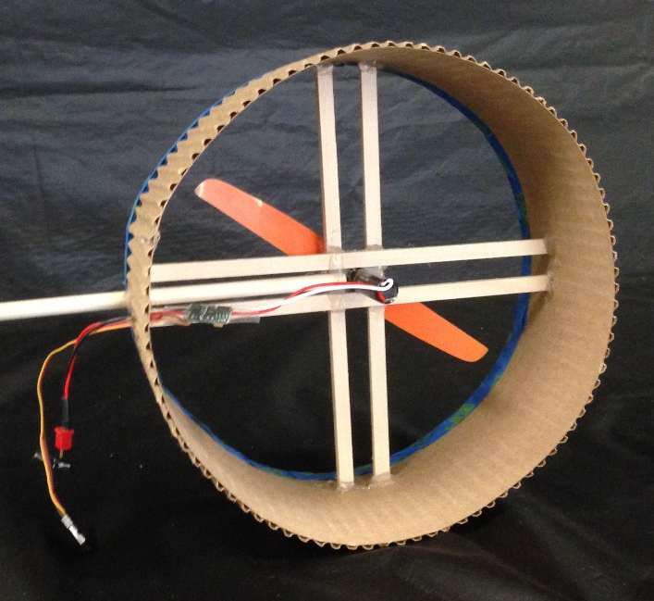
Motors: Propel Blimp
6-inch (0.15 m)
propellers
7.25-inch (0.18 m)
circular cardboard
ducts
Bass wood struts
anchor motors
and support ducts
0.5 m dowel rod connects motor
assembly to gondola
Back View
Struts
7.25 in
(0.18 m)
Dowel
Motor
Propeller

Slide 11
Motors: Control Height
Pitch Control: 180 degrees of freedom
Allows for movement in solely vertical directions
Side View
Blimp moves
up
Blimp moves down
Airflow direction

Slide 12
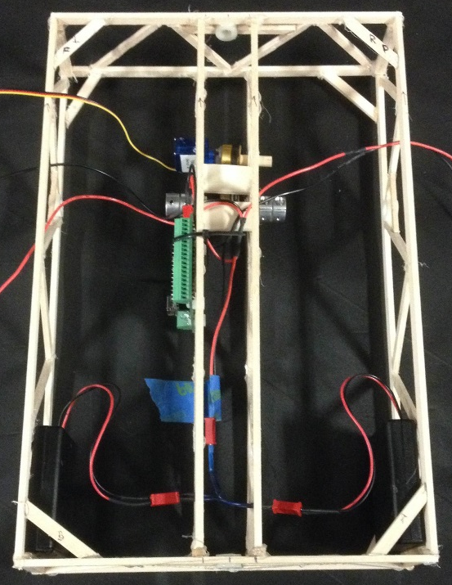
Electrical System: Powers & Controls Blimp
Power - 10 Volts
2 Battery Packs
Microcontroller
Servo
2 Motors
PWM
Microcontroller
2 Motors
Servo
Top View
Servo
Wires to motors (connected in parallel)
Microcontroller
Battery packs (connected in series)

Slide 13
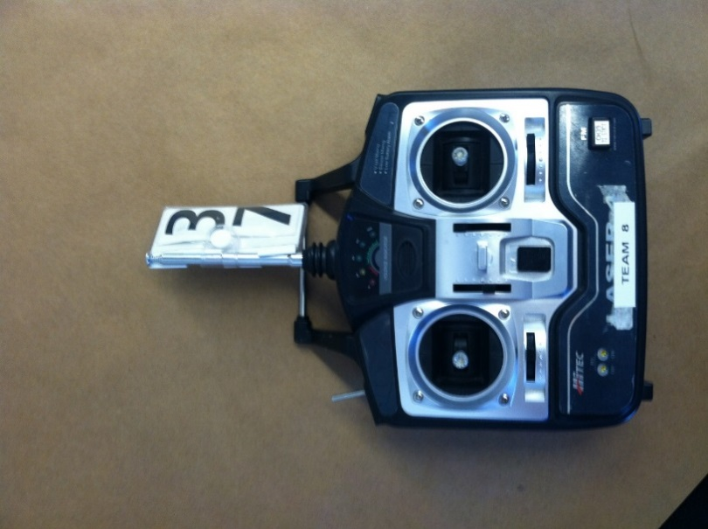
Microcontroller: Controls Pitch & Thrust
Microcontroller allows for custom controls
Left joystick controls differential thrust to both motors
Right spring-loaded joystick controls pitch
Regular
Joystick
Spring-loaded
Joystick
Up
Fast
Left
Right
Down
Slow

Slide 14
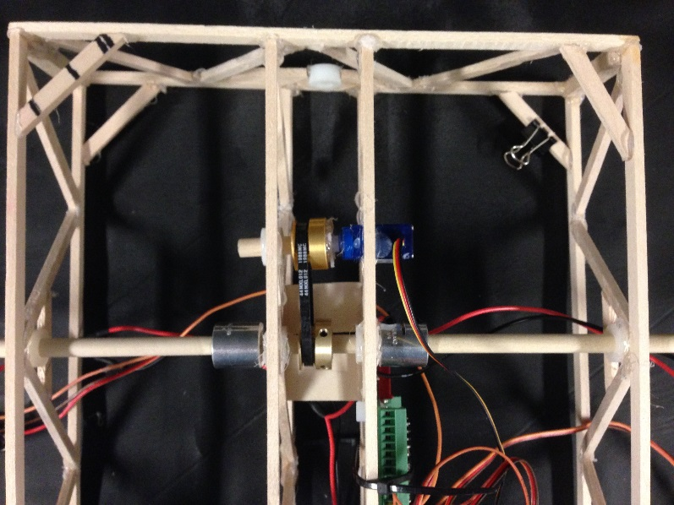
System Integration
Detachable motor assemblies
Center mechanism attaches to servo
Central dowel rod runs through membrane loops on envelope
Membrane shroud surrounds gondola
Bottom View
Side View
Motor Detachment Points
Membrane Shroud:
Fastens gondola to envelope

Slide 15
Mass Budget Under 1 kg
System | Component | Mass (g)
Payload | Camera | 100
Envelope | Envelope and Shroud Lines | 113.76
Gondola | Gondola Frame | 53.49
 | Stabilization Fin | 30
Propulsion | Right Motor Assembly | 59.46
 | Left Motor Assembly | 55.11
 | Pulley Assembly | 42.73
Electronics | Battery Pack A | 73.53
 | Battery Pack B | 71.27
 | Microcontroller | 33.38
 | Wires | 13.50
 | Receiver | 9.63
Ballast | Ballast | 50
Total |  | 706

Slide 16
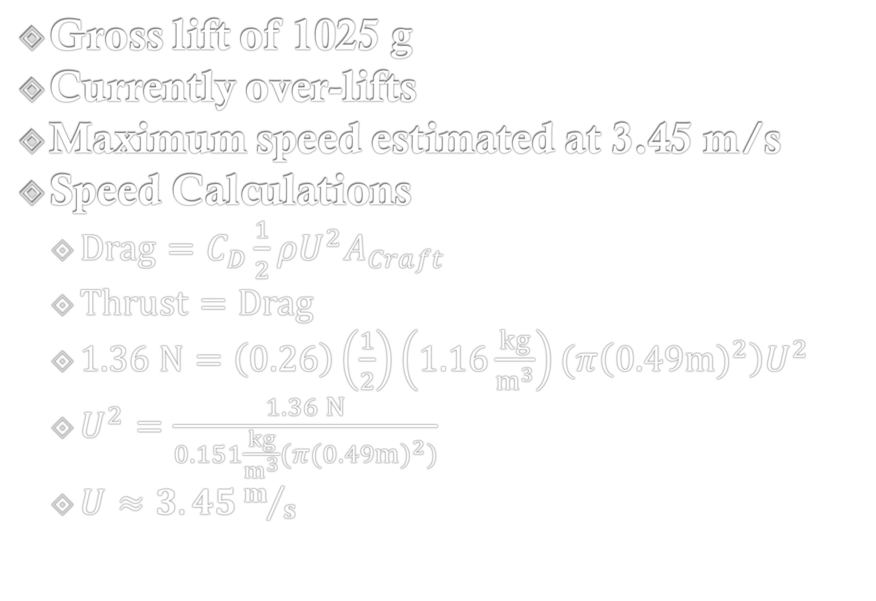
Predicted Lift and Speed
Gross lift of 1025 g
Currently over-lifts
Maximum speed estimated at 3.45 m/s
Speed Calculations
$Drag=C_{D}\frac{1}{2}ρU^{2}A_{Craft}$
$Thrust=Drag$
$1.36 N=\left(0.26\right)\left(\frac{1}{2}\right)\left(1.16\frac{kg}{m^{3}}\right)(π\left({0.49m)}^{2}\right)U^{2}$
$U^{2}=\frac{1.36 N}{0.151\frac{kg}{m^{3}}(π{(0.49m)}^{2})}$
$U≈3.45m/s$

Slide 17
Blimp Project Schedule, March 2014
Oral Pres.: Blimp Design
Blimp Fabrication
Gondola Fabrication
Motor/Propellers/Ducts
Microcontroller
Electronics and Wiring
Envelope/Shroud Lines
Blimp Testing
Completed

Slide 18
Blimp Project Schedule, March-April 2014
Written Progress Report
Demonstration Flight
Oral Pres.: Blimp Progress
Blimp Testing/Alterations
Qualification Flight
Final Oral Presentation
Blimp Competition
Final Team Report

Slide 19
Management and Task Responsibilities
Name | Reporting Management | Construction Management | Hands-on Construction
Alex Berka | Final Report | Motor Ducts | Motor Ducts, Gondola
Valerie Chen | Blimp Written Progress Report | Gondola | Gondola, Envelope
Dietrich Klemm | Final Presentation | Electronics: Microcontroller Programming | Wiring, Microcontroller
Umang Lohia | Presentation on Blimp Progress | Electronics & Wiring | Wiring, Envelope
Carlos Valls | Presentation on Blimp Design | Envelope | Envelope, Gondola
*Note that all members contributed to all reporting assignments

Slide 20
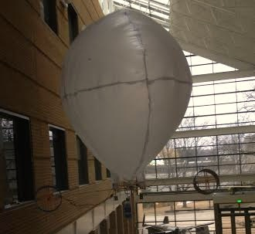
Conclusion
Blimp design: Prolate spheroid
Meets all NASA requirements
Wide motors and differential thrust for yaw
Microcontroller controls pitch of motors
System mass: 672.95 g/1000 g
Progress
Blimp complete except fin
First test flight complete
To be completed
Stabilizing membrane fin
Blimp testing, alterations, and pilot practice
Project on schedule, work evenly divided

Slide 21
Estimating Thrust
7 in Propeller
6 in Propeller
5 in Propeller
Figure produced by Alex Berka from lab data

Slide 22
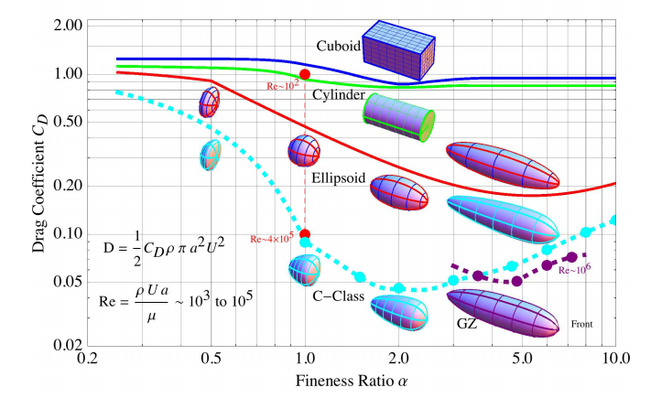
Estimating C_{D}
Chart created by Prof. Washabaugh: Lab 06 Thrust vs Drag

